Slide 1
Chongqing University of Technology
ATAI
Advanced Technique of Artificial Intelligence
Chongqing University of Technology
Behavior-Contextualized Item Preference Modeling for Multi-Behavior Recommendation
Code：https://github.com/MingshiYan/BIPN
—— SIGIR 2024
2024.5.12 • ChongQing
Reported by Peng Shan

Slide 2
Motivation
（1）The direct information transfer from the auxiliary behaviors to the target behaviors may introduce noise due to the variation of user focus across different behaviors.
（2）This variation in user focus is prevalent not only across different behaviors but also within the same behavior, influenced by the specific characteristics of each item. However, current CF-based recommendation methods tend to overlook these nuanced preferences.

Slide 3
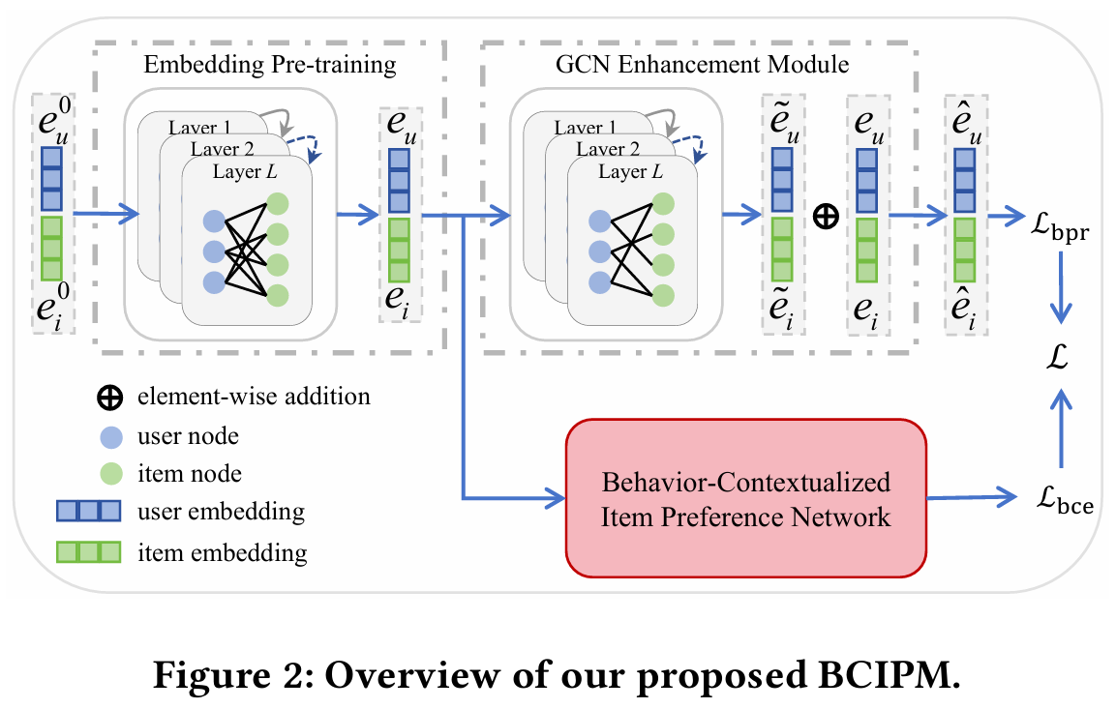
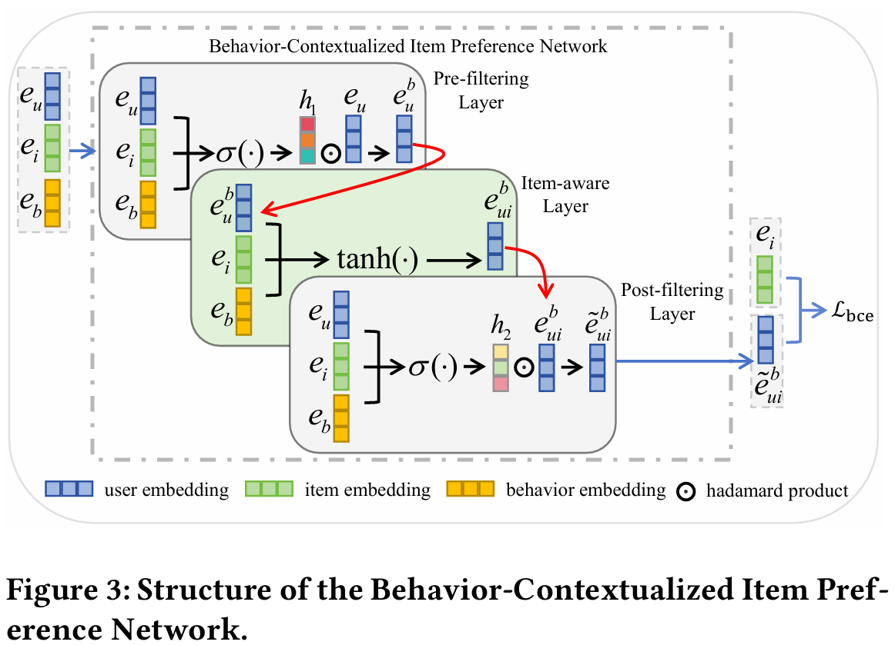
Method

Slide 4
Method
$$α= 1/(l+1)$$

Slide 5
Method

Slide 6
Method

Slide 7
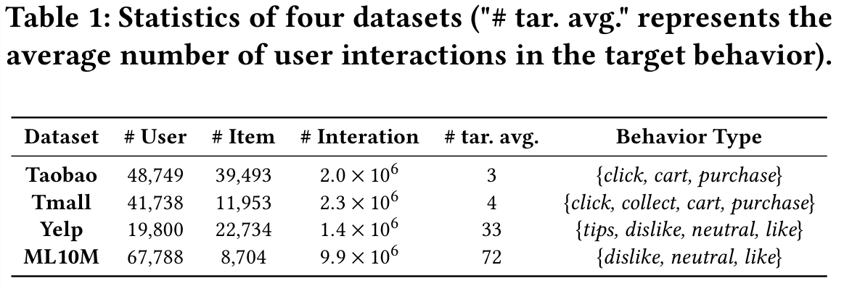
Experiments

Slide 8
Experiments

Slide 9
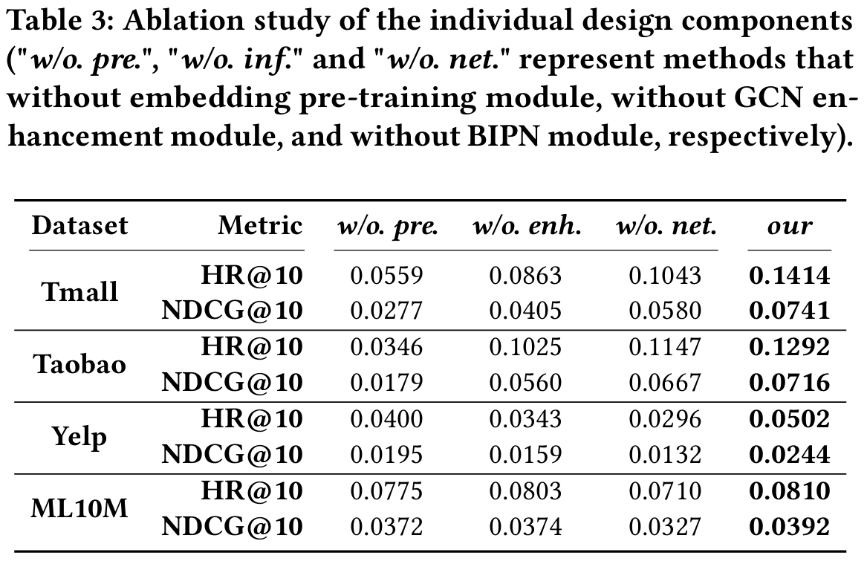
Experiments

Slide 10
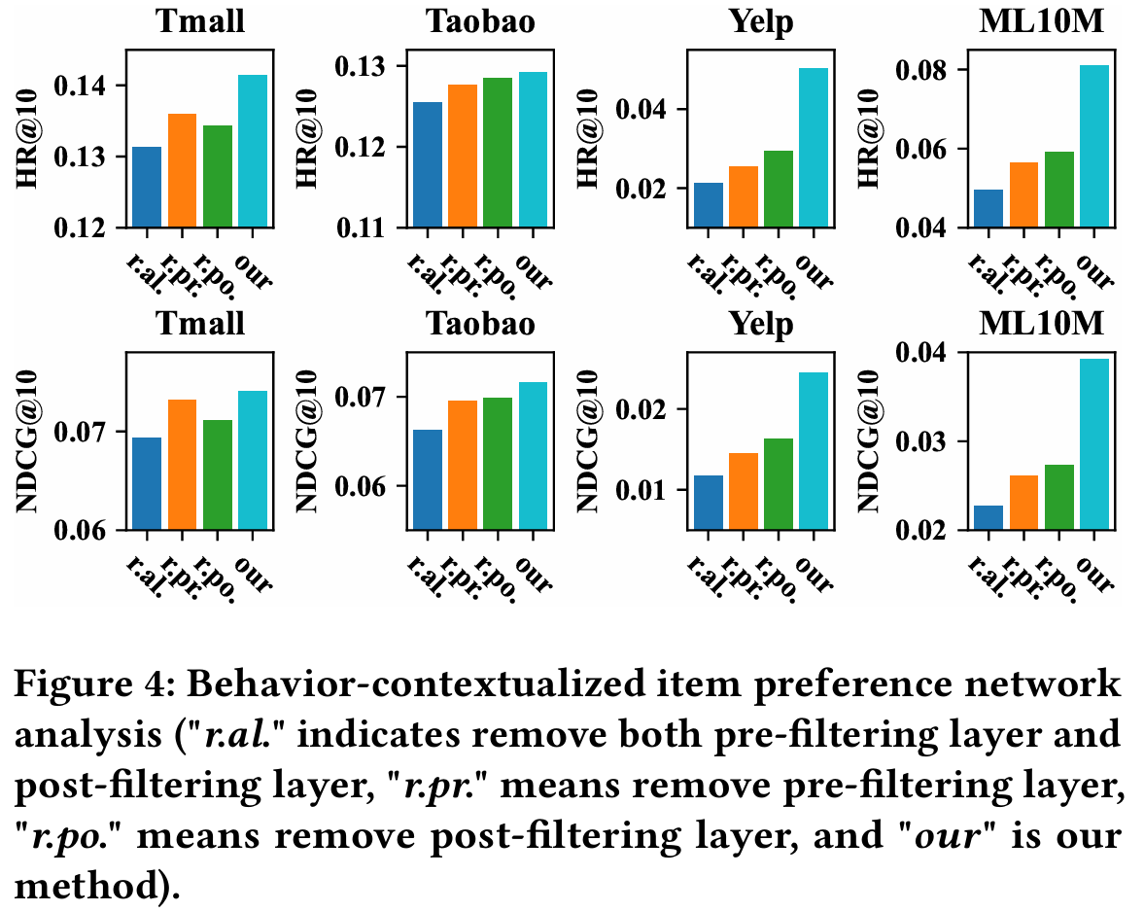
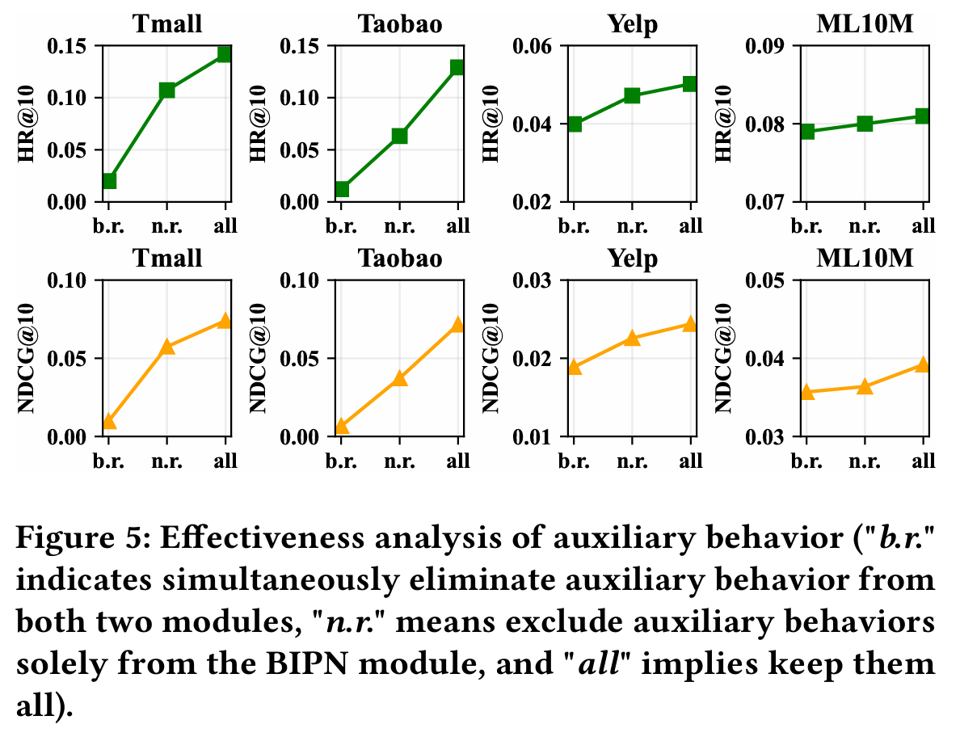
Experiments

Slide 11
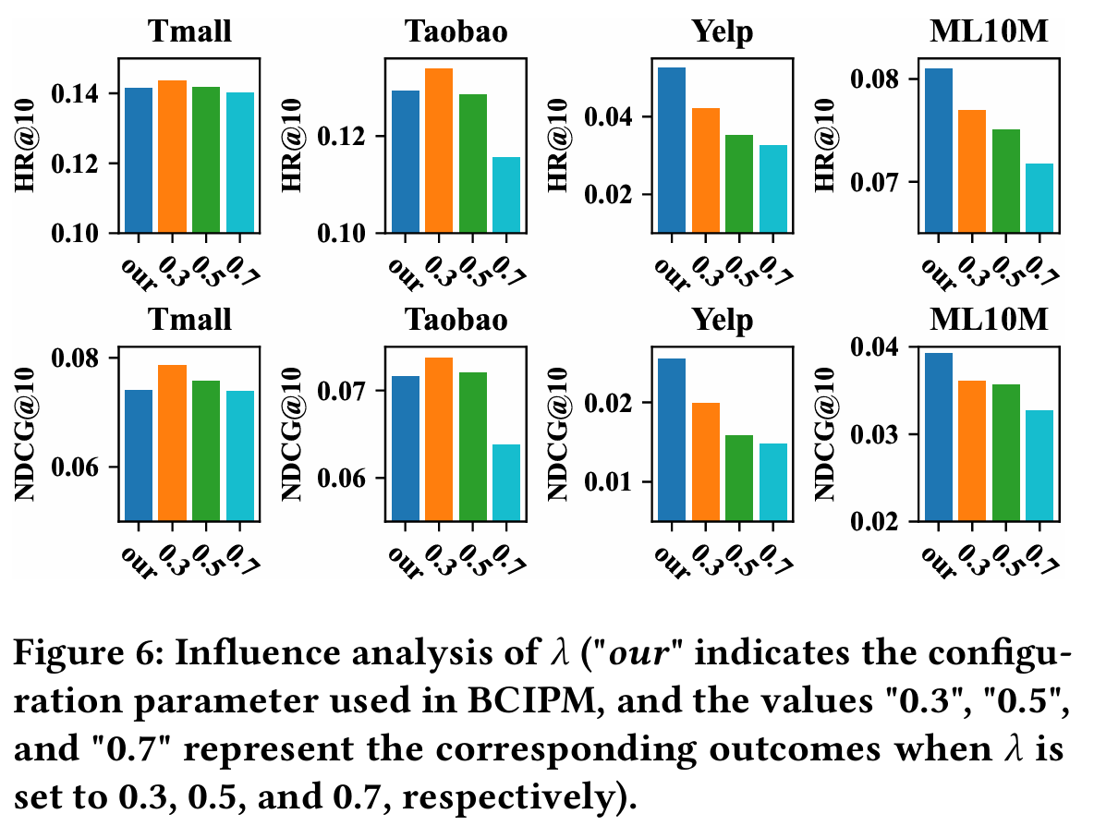
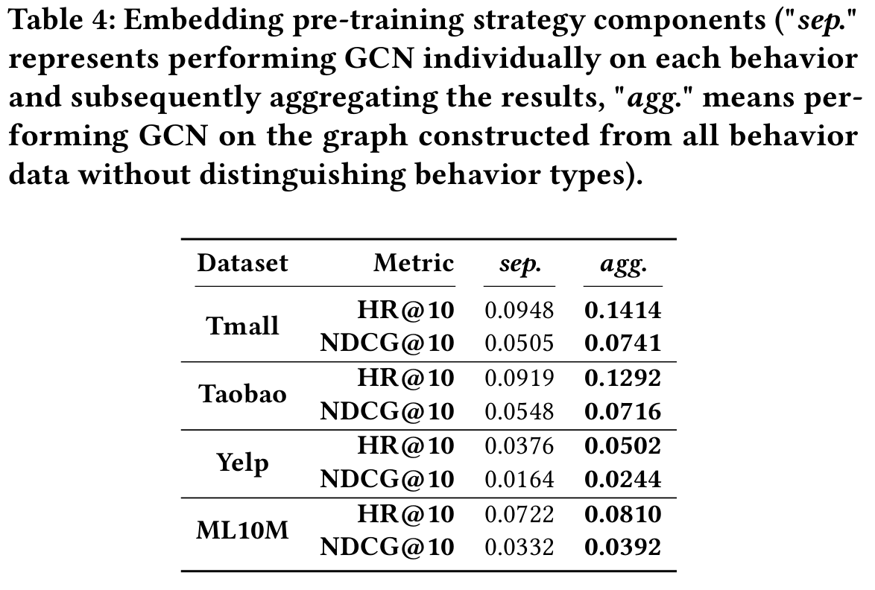
Experiments

Slide 12
Thanks!

